Slide 1

Academic Paper Search Solution: An innovative platform revolutionizing research discovery. Developed by a team of passionate computer science students, this presentation showcases our advanced multi-source academic research tool.

Slide 2




Our Team
A team of four dedicated computer science graduate students. - AI Specialist (Image: r2PyR): Leading algorithm design and implementation. - Machine Learning Expert (Image: CISHn): Expertise in data analysis, statistical modeling, and model training. - Web Technology Guru (Image: EFGpG): Responsible for front-end user interface and back-end system architecture. - Project Manager (Image: 2NYM0): Facilitating team collaboration and ensuring timely achievement of project milestones.

Slide 3

Problem Statement
Academic research is often time-consuming due to a fragmented landscape across multiple platforms. Existing search tools frequently lack relevant results, hindering efficient research discovery. Improving the search process is essential.
1
Fragmented Data: Information scattered across various databases and journals.
Limited Relevance: Current search algorithms miss crucial connections.
Time-Consuming Process: Researchers spend excessive time filtering irrelevant results.
Accessibility Barriers: Paywalls and subscription fees hinder widespread access to knowledge.

Slide 4

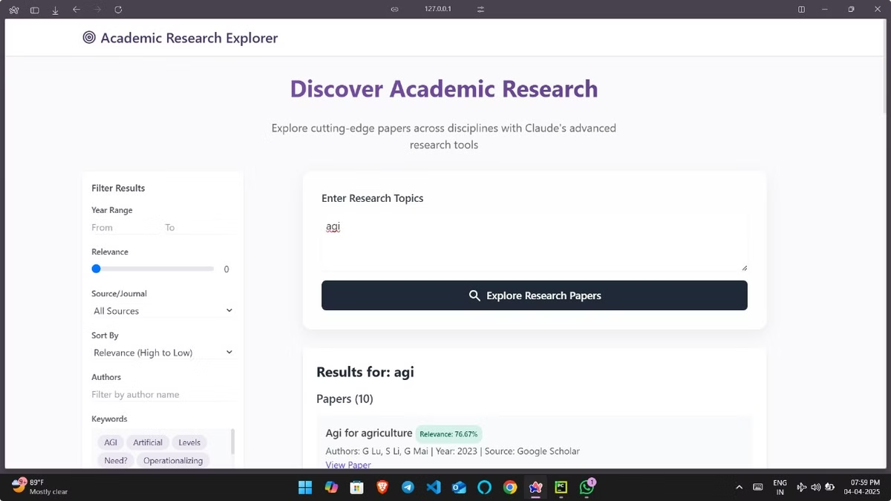
Solution Overview
- Centralized platform streamlining academic paper search: Our solution provides a single point of access to academic papers, eliminating the need to navigate multiple websites and databases manually.
- Seamlessly integrates multiple research databases for comprehensive results: We integrate with leading research databases, ensuring that our users receive a broad and comprehensive set of results, maximizing the chances of discovering relevant papers.
- Employs an intelligent algorithm to ensure highly relevant search outcomes: Our intelligent search algorithm uses advanced techniques to analyze the content and metadata of academic papers, ensuring that the most relevant results are prioritized and displayed to the user.
- Your all-in-one solution for efficient research discovery: With our centralized platform, comprehensive integration, and intelligent algorithm, researchers can significantly reduce the time and effort required to find the papers they need, leading to more efficient and productive research.

Slide 5

Key Features
- Multi-source search: Access over 10 academic databases, including JSTOR, IEEE Xplore, and PubMed, all from a single interface. - Advanced relevance scoring: Employs a powerful AI algorithm that analyzes paper content, citations, and author profiles to provide highly accurate relevance scores. - Real-time result filtering and ranking system: Offers dynamic filtering options such as publication date, author, and keywords, allowing you to refine search results instantly. - Efficient research discovery in seconds: Dramatically reduce the time spent on literature reviews with our streamlined search process, delivering relevant results within seconds.

Slide 6
System Architecture
Our system architecture is designed with scalability, modularity, and high performance in mind. Leveraging a microservices-based distributed architecture, we ensure each component can be independently scaled and updated, promoting adaptability and resilience. Seamless integration of multiple data sources is achieved through a well-defined API layer, facilitating comprehensive data aggregation. Our high-performance search mechanism employs efficient indexing and query optimization techniques to deliver rapid and relevant results.
1
Data Ingestion
Data is ingested from multiple academic databases via APIs.
2
Indexing
The data is then indexed using our proprietary algorithm.
3
Query Processing
The user query is processed and matched against the index.
4
Result Ranking
Results are ranked based on relevance scoring.
5
Presentation
The ranked results are presented to the user.

Slide 7

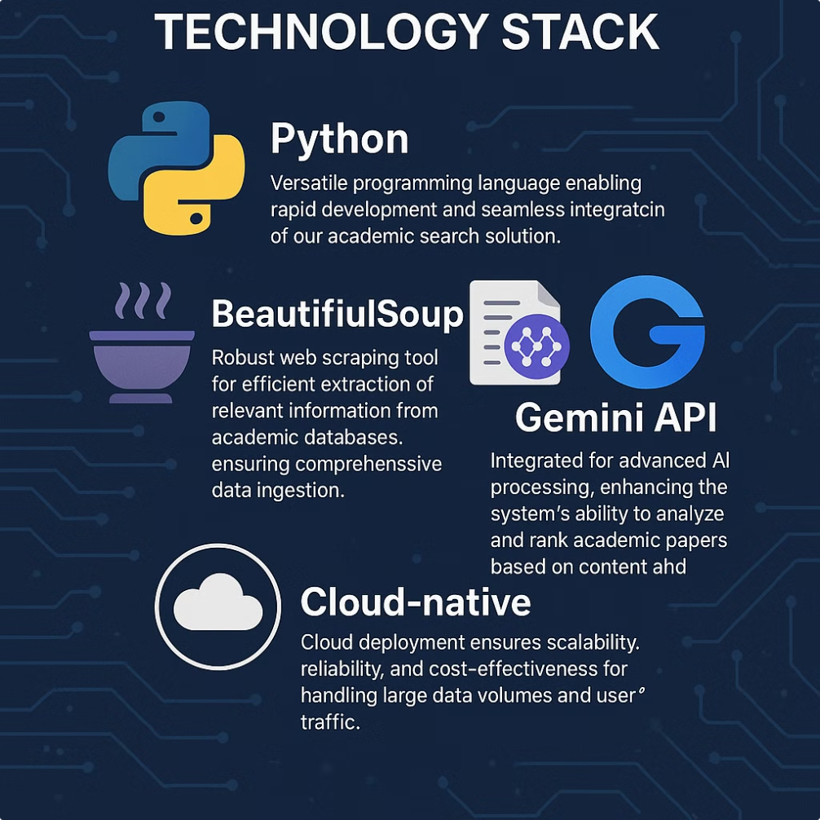
Technology Stack
Python: Versatile programming language enabling rapid development and seamless integration of our academic search solution.
BeautifulSoup: Robust web scraping tool for efficient extraction of relevant information from academic databases, ensuring comprehensive data ingestion.
SentenceTransformer: Enables advanced semantic search, allowing the system to understand context and improve the accuracy of search results.
Gemini API: Integrated for advanced AI processing, enhancing the system's ability to analyze and rank academic papers based on content and citations.
Cloud-native: Cloud deployment ensures scalability, reliability, and cost-effectiveness for handling large data volumes and user traffic.

Slide 8

Project Insights
- Overcame significant technical challenges in multi-source data integration: Successfully navigated complexities in harmonizing data from diverse academic databases, ensuring seamless access to comprehensive research literature.- Learned advanced AI integration techniques: Mastered the application of state-of-the-art artificial intelligence algorithms for semantic search, resulting in enhanced accuracy and relevance of search results.- Scalable search solution developed for efficiency: Engineered a microservices-based architecture, enabling the system to handle large data volumes and user traffic with optimal resource utilization and responsiveness. - Potential for academic research optimization: Aims to streamline literature reviews and accelerate the pace of discovery, fostering innovation and collaboration within the academic community.

